Slide 1
SESSION 22
Neural Networks for NLP
From Counting Words to Modeling Sequences
Feed-forward nets give text a brain; recurrence gives it a memory.
We build intuition for why RNNs, LSTMs and GRUs were invented — not the math.
FFN · Embeddings · RNN · Vanishing Gradients · LSTM · GRU

Slide 2
Today's Agenda
What we'll cover — roughly half theory (slides) and half hands-on (notebook)
01
From Words to Networks
04
Sequence Modeling & RNNs
Why bag-of-words needs a model on top
Adding memory: the vanilla RNN
02
Feed-Forward Networks
05
Vanishing Gradients
The basic neural building block
Why simple RNNs forget
03
Embedding Layers
06
LSTMs & GRUs
Turning word IDs into learnable vectors
Gates that protect long-term memory
Session 22 · Neural Networks for NLP
2

Slide 3
Where Session 21 Left Off
We can turn words into vectors — but a vector alone makes no prediction
Embeddings give every word a dense vector that captures meaning. But an embedding is just an input.
To answer a question — Is this review positive? What word comes next? — we need a model that combines those vectors and learns.
Raw text
→
Tokens / IDs
→
Embeddings
→
Neural network
→
Prediction
Today is about that orange box. We start with the plainest network, then give it memory so it can read sequences in order.
Session 22 · Neural Networks for NLP
3

Slide 4
Why Add a Neural Network?
Counting words throws away the two things language depends on
Order is lost
The shift
“dog bites man” and “man bites dog” have identical word counts — opposite meaning.
From hand-built features
↓
to learned representations
A network adjusts millions of weights so the right answer becomes likely.
Meaning is shallow
Bag-of-words treats every word as independent; it can't compose ideas.
Fixed rules don't scale
Hand-written features break on new phrasing. We want the model to learn patterns.
Session 22 · Neural Networks for NLP
4

Slide 5
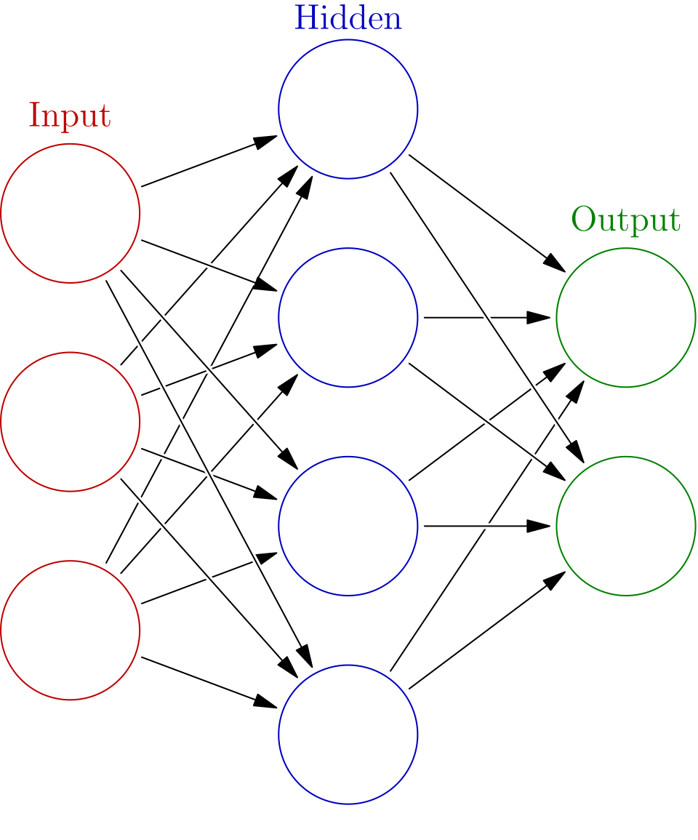
Feed-Forward Networks
The basic building block: information flows one way, input → output
Neurons in layers. Each neuron takes numbers in, multiplies them by weights, adds them up, and passes the result through a simple non-linear function.
Layers stack. Early layers detect simple patterns; later layers combine them into something useful.
Learning = tuning weights. We compare the output to the truth, measure the error, and nudge every weight to shrink it (backpropagation).
Limitation: a plain FFN expects a fixed-size input and has no sense of order.
Feed-forward net · Glosser.ca, CC BY-SA 3.0
Session 22 · Neural Networks for NLP
5

Slide 6
Embedding Layers
The bridge from word IDs to vectors the network can learn
A network can't read “cat” — only numbers. An embedding layer is a lookup table: each word ID points to a row of numbers (its vector).
Embedding matrix (vocabulary × dimensions)
Why it matters
ID 42
0.21 -0.43 0.88 0.05
← cat
• Rows start random and are learned with the rest of the network.
• Similar words drift to similar rows — meaning emerges from training.
• In PyTorch this is one line:
nn.Embedding(vocab, dim)
ID 8
0.62 0.10 -0.27 0.44
← sat
ID 57
0.19 -0.38 0.79 0.12
← mat
Session 22 · Neural Networks for NLP
6

Slide 7
A First Neural Text Model
Embedding + feed-forward net — and the wall it hits
Embed
→
Pool
→
FFN
→
Predict
each word → vector
average all vectors
hidden layer learns
positive / negative
This already beats bag-of-words on many tasks. But averaging throws away word order — the same flaw as counting.
Both read the same:
“not good, really bad”
“really good, not bad”
Average is identical → same prediction.
What we actually need:
a model that reads word by word
and remembers what came before.
That is a recurrent network.
Session 22 · Neural Networks for NLP
7

Slide 8
Sequence Modeling
Process inputs one step at a time, carrying memory forward
A sequence model reads a list in order and keeps a running summary — a hidden state — updated at every step.
The
movie
was
not
good
↓
↓
↓
↓
↓
h1
→
h2
→
h3
→
h4
→
h5
Each box passes its memory to the next. By the last step, the state has ‘read’ the whole sentence.
Key idea: same small network is reused at every step (it 'recurs'). That's what makes it a Recurrent Neural Network.
Session 22 · Neural Networks for NLP
8

Slide 9
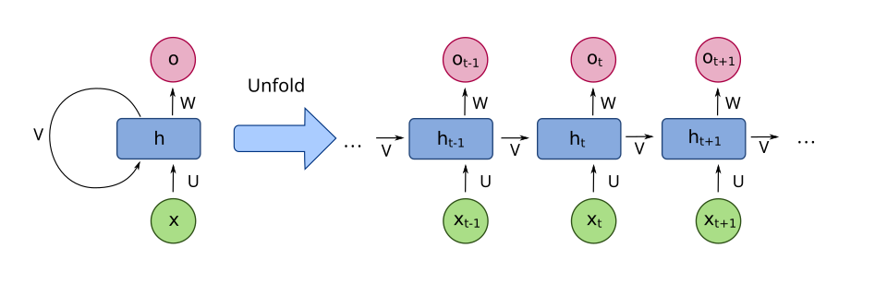
The Vanilla RNN
One cell, applied again and again — 'unrolled' across time
x
the input word at this step
h
the hidden state — memory carried forward
o
the output / prediction at this step
Recurrent neural network, folded vs unfolded · fdeloche, CC BY-SA 4.0
Session 22 · Neural Networks for NLP
9

Slide 10
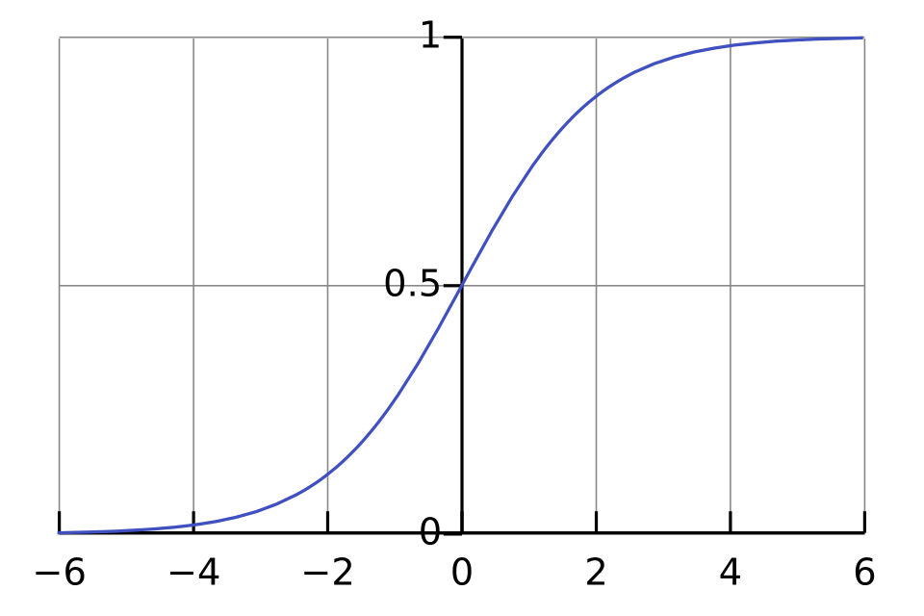
The Catch: Vanishing Gradients
Why a plain RNN forgets the start of a long sentence
To learn, the error signal travels backward through every step.
At each step it's multiplied by a small number (the slope of the squashing function, often < 1).
Multiply many small numbers and the signal shrinks toward zero.
Result: early words get almost no learning signal — the network can't connect 'not' at the start to 'good' far later.
Sigmoid: flat tails → tiny slopes · Qef, Public domain
The opposite can also happen (exploding gradients). Both made deep/long RNNs hard to train — motivating gated cells.
Session 22 · Neural Networks for NLP
10

Slide 11
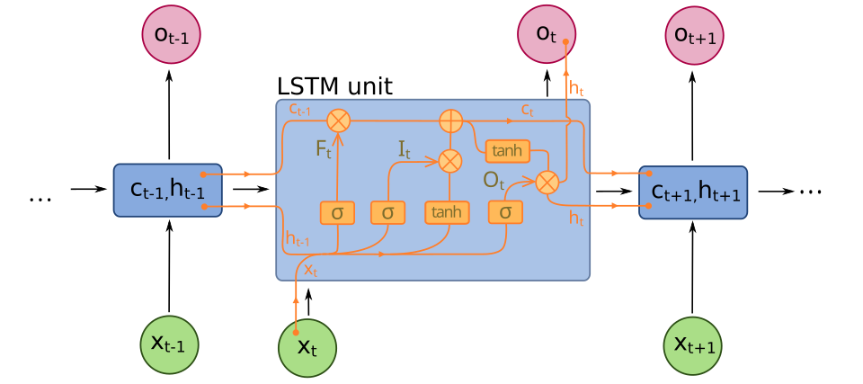
LSTM: A Memory That Lasts
Long Short-Term Memory adds a protected 'cell state' plus gates
The big idea
The cell state runs straight across the top — a conveyor belt for memory.
Information rides along almost unchanged, so gradients don't vanish.
Small gates decide what to add or remove at each step.
LSTM cell: cell state on top, three gates below · fdeloche, CC BY-SA 4.0
Session 22 · Neural Networks for NLP
11

Slide 12
The Three Gates
Each gate is a tiny network that outputs 'how much' (0 = block, 1 = pass)
Forget gate
σ
Reads the new word and decides which parts of the cell state are no longer useful.
What old memory should we drop?
Input gate
σ
Picks which new information is worth writing into the cell state.
What new memory should we add?
Output gate
σ
Decides which part of the memory becomes this step's hidden state / output.
What do we reveal right now?
Session 22 · Neural Networks for NLP
12

Slide 13
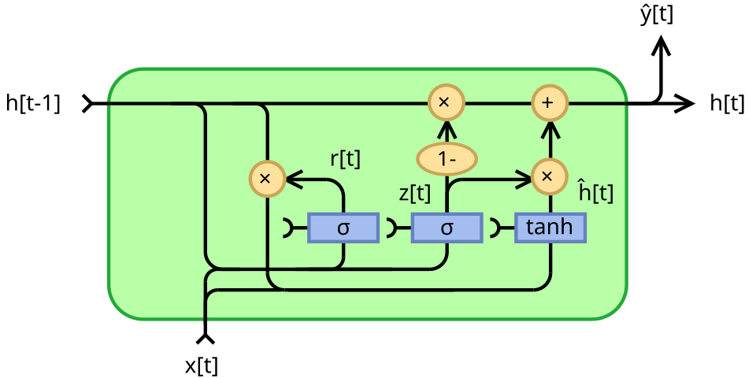
GRU: The Streamlined Cousin
Gated Recurrent Unit — same goal, fewer parts
Two gates, no separate cell
Update gate — how much old memory to keep vs refresh.
Reset gate — how much past to ignore when forming new memory.
Fewer parameters → faster to train, often as accurate as an LSTM.
GRU cell: reset + update gates · Jeblad, CC BY-SA 4.0
Session 22 · Neural Networks for NLP
13

Slide 14
RNN vs LSTM vs GRU at a Glance
Same family, increasing ability to remember
Feature
Vanilla RNN
LSTM
GRU
Memory
Hidden state only
Hidden + cell state
Hidden state only
Gates
None
3 (forget/input/output)
2 (reset/update)
Long sequences
Forgets quickly
Strong
Strong
Parameters
Fewest
Most
Middle
Use when
Short sequences, teaching
Long dependencies
Good default, faster
Session 22 · Neural Networks for NLP
14

Slide 15
Why Learn These If Transformers Won?
The core idea survived
Hidden state, memory, gating — attention and transformers build on these same instincts.
They explain the problem
RNNs make 'why is long-range memory hard?' concrete — the question transformers answer.
Still everywhere
LSTMs/GRUs run in production for time series, speech, and on small/edge devices.
Goal for today: understand why each was invented — not to master the equations.

Slide 16
Recap & What's Next
The thread from this session into the rest of the course
Recap
Next session
Feed-forward nets learn from fixed inputs but ignore order.
The limits we hit today — long-range memory — are exactly what attention and Transformers solve.
Hands-on now: build a char-level RNN/LSTM/GRU in the notebook.
Embedding layers turn word IDs into learnable vectors.
RNNs add memory by reusing one cell across a sequence.
Vanishing gradients make plain RNNs forget long-range context.
LSTMs & GRUs use gates to protect memory over long spans.
Image credits: Wikimedia Commons — feed-forward net (Glosser.ca, CC BY-SA 3.0); RNN & LSTM (fdeloche, CC BY-SA 4.0); GRU (Jeblad, CC BY-SA 4.0); sigmoid (Qef, public domain).
Session 22 · Neural Networks for NLP
16

